Slide 1
DR.SNSRCAS, CBE
SUBJECT: ADVANCED JAVA PROGRAMMING
COURSE CODE:16UCA502
TITLE: Internationalizing Struts Applications
YEAR: V SEMESTER 2022-2023 (ODD)

Slide 2
Internationalizing Struts Applications.
Internationalization (i18n) is the process of planning and implementing products and services so that they can easily be adapted to specific local languages and cultures, a process called localization. The internationalization process is called translation or localization enablement.

Slide 3
Internationalizing Struts Applications.
Internationalization is abbreviated i18n because the word starts with the letter “i” and ends with “n”, and there are 18 characters between the first i and the last n. Struts2 provides localization, i.e., internationalization (i18n) support through resource bundles, interceptors and tag libraries in the following places

Slide 4
Internationalizing Struts Applications.
The UI Tags
Messages and Errors.
Within action classes.

Slide 5
Internationalizing Struts Applications.
Localization Example
Let us target to create index.jsp from the previous chapter in multiple languages. Same file would be written as follows −

Slide 6
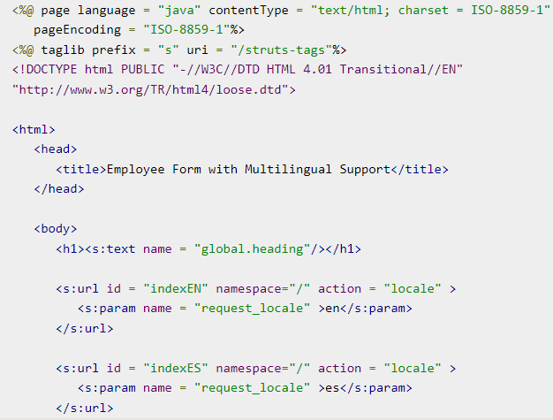
Internationalizing Struts Applications.

Slide 7
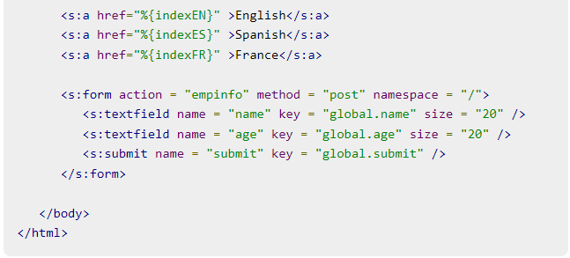
Internationalizing Struts Applications.

Slide 8
THANK YOU

